Slide 1
Event Management
Dag 2

Slide 2

Purpose
Discover events
Understand what they are about
Decide appropriate response

Slide 3
Event / Alarm Definition
Event definition
Alarm definition
A change of a state that affects the management of a configuration item or IT service.
The term event is also used in the sense of alarm or notification from an IT service, configuration item or monitoring tool.
Events usually require that IT Operations staff perform an action, and events often cause an incident to be detected.
An alarm is a warning that a limit value has been reached, something has changed or an error has occurred.
Alarms are often created and handled by system management tools.
The alarms are handled by the Event management process.

Slide 4
Event Management
Introduction
Event Management is a process included in the ITIL - Service Operation phase:
By definition, an event is a "change of state that has significance for management of an IT service or other configuration item (CI)".
Events are typically recognized through alerts or notifications detected by a monitoring tool.
Advantages
Provides mechanisms for early detection of incidents.
In many cases, it is possible for the event to be detected and assigned as an incident to the appropriate group for action before any actual service outage occurs.
Automated detection takes into consideration significant alerts or notifications, thus removing the need for expensive and resource-intensive real-time monitoring.

Slide 5
Configuration Item (CI)
A configuration item (CI) is defined by ITIL as “any component or other service asset that needs to be managed in order to deliver an IT service.
Information about each configuration item is recorded in a configuration record within the configuration management system - CMS.
Configuration Items (CI) are under control of change management.”
Configuration Item (CI)
Configuration Items refers to the Fundamental Structural Devices of the Configuration Management Database (CMDB) (Configuration Management System (CMS))
CI’s can be:
Hardware
Software
Communications/Networks
Locations
Documentation
People (Staff and Contractors)

Slide 6
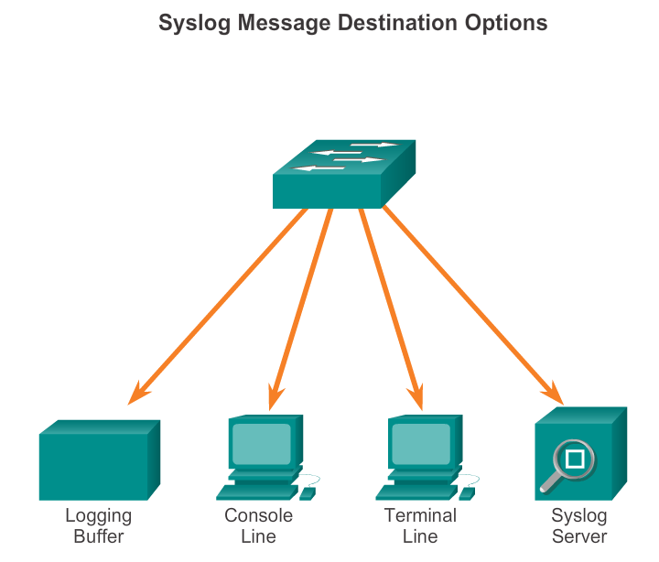
Syslog Operation Syslog Operation
Syslog messages can be sent to various destinations.
Can be sent to external syslog server. These messages can be retrieved without accessing the server. Can be pulled into reports.
Syslog messages can be sent to internal buffer and will only be viewable from CLI of the devise.
Network administrator may specify, certain type of syslog system messages sent to various destinations: For example:
Forward all system messages (syslog messages) to an external syslog server
Debug-level messages are forwarded to internal buffer. Are only accessible by network admin. from CLI.
It is possible to access the device through Telnet or SSH to view the log messages.
Configure a router or switch to send log messages to a syslog server, add global command:
logging {address|hostname}
Notes:
8.1.1.2 Syslog Operation

Slide 7
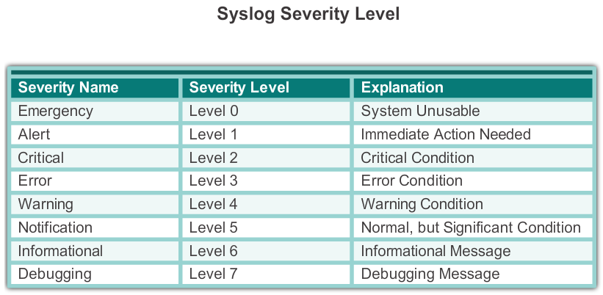
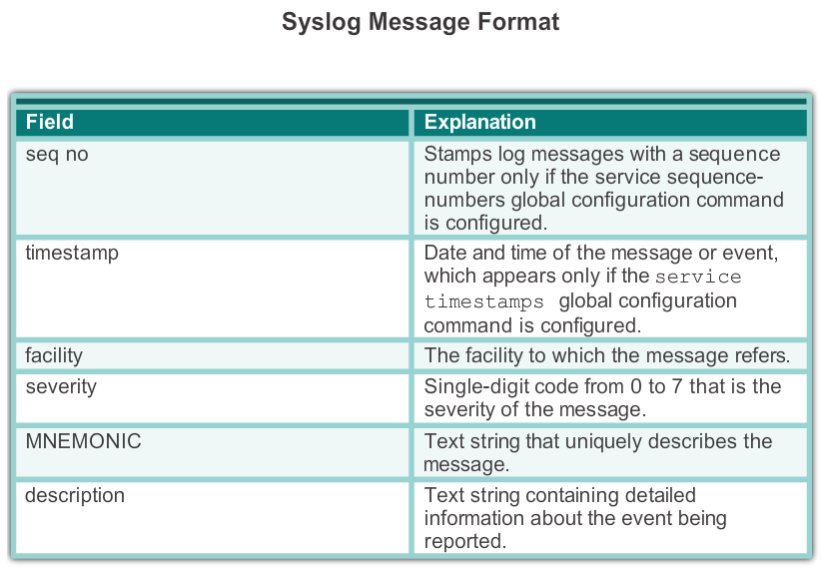
Syslog Message Format
Cisco devices generates syslog messages as a result of network events.
Every syslog message contains a level.
The smaller numerical levels are more critical
Warning level: means the functionality of the device is affected.
Notification level: only for info. The functionality of the device is not affected.
Debugging level: messages are output generated from issuing debug commands.
Syslog messages format on Cisco IOS software:
seq no: timestamp: %facility-severity-MNEMONIC: description
Notes:
8.1.1.3 Syslog Message Format

Slide 8
Configuring Syslog Router and Switch Commands for Syslog Clients
There are 3 steps to configure the router to send log messages to a syslog server for storage:
1- configure the destination IP address or hostname of the syslog server, in global config mode:
logging {address|hostname}
2- control the message that will be sent to the syslog server with the logging trap level. Use one of these 2 commands:
R1(config)# logging trap 4 //limit message to level 4 and lower(0-4) / OR
R1(config)# logging trap warning
3- configure the source interface, in global config mode with:
R1(config)# logging source-interface g0/0

Slide 9
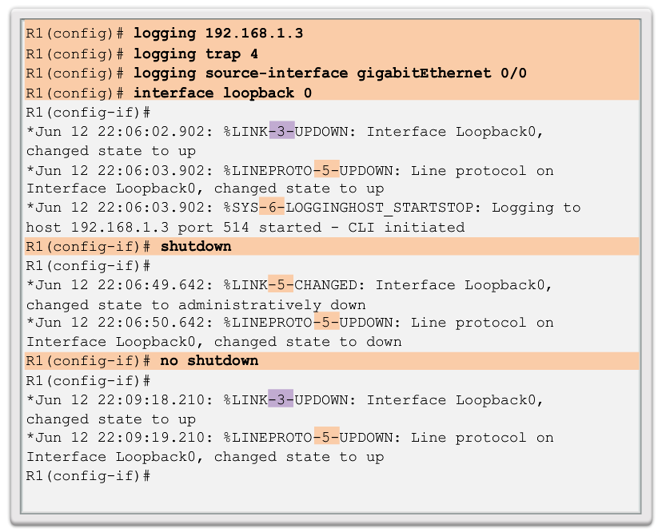
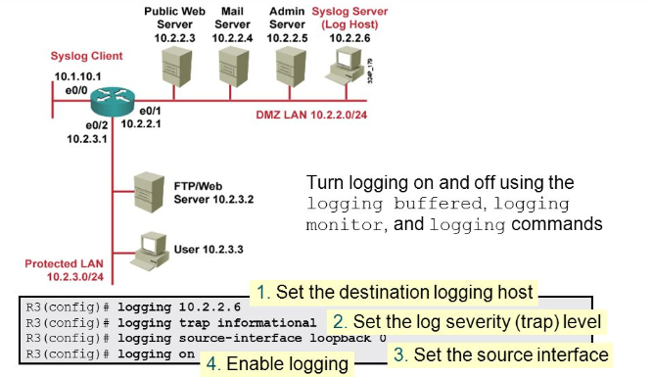
Configuring Syslog Router and Switch Commands for Syslog Clients
Below steps should be followed to configure the router to send system messages to a syslog server.
R1 is configured to send log message of level (4 down to 0) to the syslog server at IP 192.168.1.3 (target IP address)
The source interface is G0/0.
Loopback interface is created, first shutdown, and then brought up to generate an event (state change).
The console output reflects these actions.
When create loopback 0, the interface comes up.
Notes:
8.1.2.3 Router and Switch Commands for Syslog Clients

Slide 10
SNMP- Simple Network Management
SNMP is developed to manage nodes, such as a router, switches, server, workstation, on an IP network. It enables network administrator to find and solve network problems.
SNMP Is application layer protocol. SNMP system consist of 3 elements:
SNMP manager
SNMP agent
Management Information (Data)Base – MIB.
SNMP manager runs SNMP management software.
SNMP manager collects information's from SNMP agent (ask the device for data), using: ”get” action,
and can change configurations on an agent using: ”set” action. (set can cause a router to reboot, send a configuration file, receive config file.
SNMP agent can forward information directly to an NMS (SNMP Manager), using: ”trap” action.
Network devices that must be managed, switches, routers, servers, firewalls, are equipped with an SNMP agent software module.
MIB’s store data about the device operation, must be available to authenticated remote users.
SNMP uses UDP port 162, to retrieve and send management information.

Slide 11
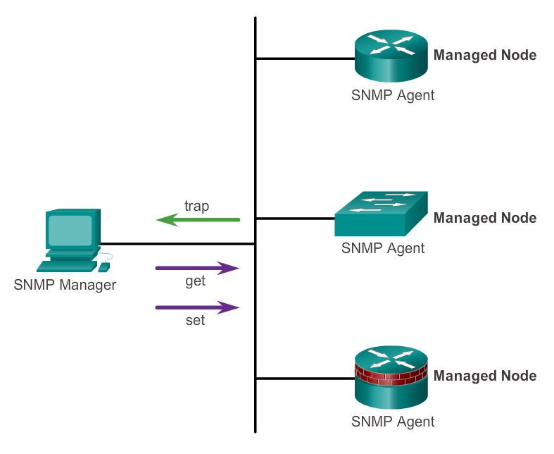
Introduction to SNMP
SNMP uses UDP port 162, to retrieve and send management information
Notes:
8.2.1.1 Introduction to SNMP

Slide 12
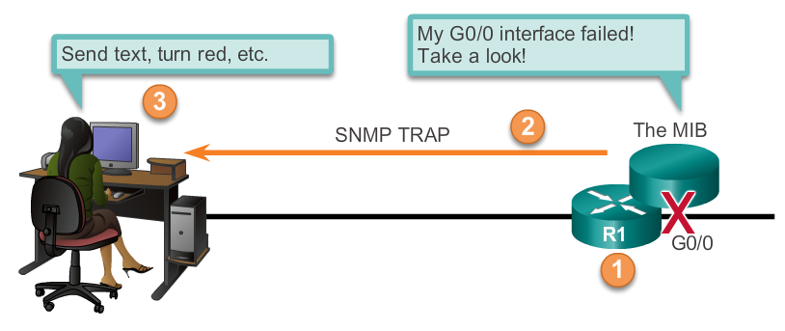
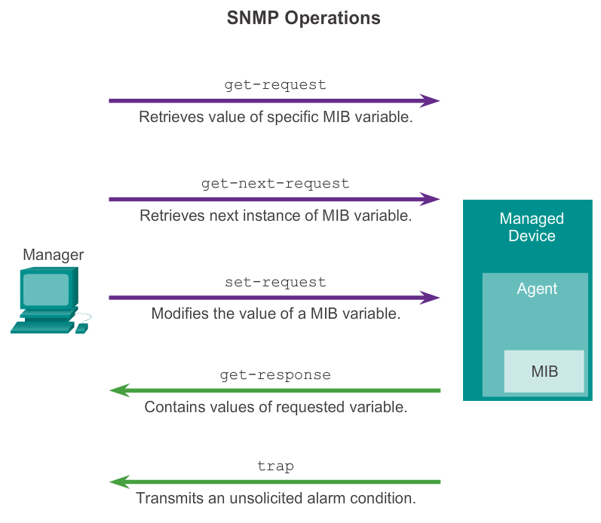
SNMP Agent Traps
NMS periodically querying the device for data, using ”get” request.
In this way SNMP manager collect info to monitor traffic load.
This info can be displayed on NMS via GUI.
Average, minimum or maximum can be calculated, data can be graphed.
SNMP manager sample the value periodically and present this info for network admin to use in creating a baseline.
Notes:
8.2.1.3 SNMP Agent Traps

Slide 13
Event Types
There are 3 event types:
Information:
Type of event that requires no action. Typically used to confirm the status of an equipment or a service. Examples:
notification that a scheduled task has been completed or
a user has logged in
Job was completed successfully
Warning:
Generally generated when a limit value is reached, so someone can react before it goes wrong. Example:
Disk space on a server is used at 65% and increases; if it reaches 75%, the response time becomes unacceptable.
Exception:
Type of event indicating that an equipment functions abnormally which causes or may cause a negative impact on business activities. Examples:
A server is down
More that 150 users have logged simultaneously on an application
A network segment is not responding to routine requests

Slide 14
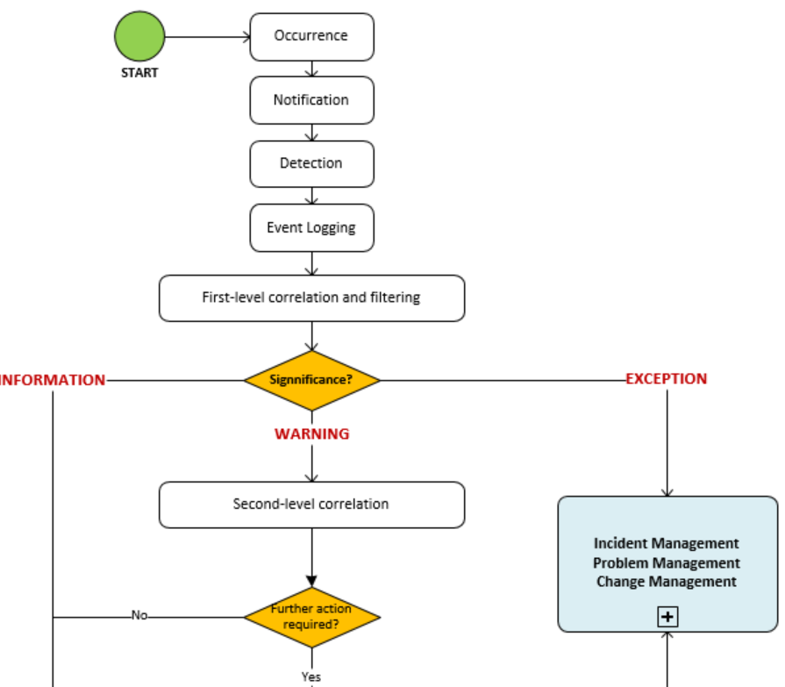
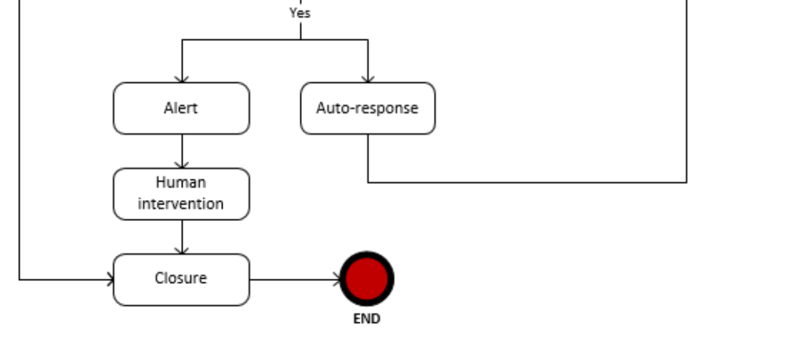
Event Management Proces
“Warning" event
"Exception" event
In case of Warning/Human Action, a notification is sent to the group responsible of the affected configuration item
create an incident, problem or change and the new request will be managed through the corresponding processes

Slide 15
Event Management Proces (cont.)
Activities
Occurrence: Among all the events that occur, which ones should be detected, must be determined.
Notification: Issued by a CI or by a monitoring tool.
Detection: Once the notification is received, it is interpreted by the monitoring system or another management tool.
Event Logging: Creation of the event request type in the request management tool.
First-level of correlation and filtering: According to the rules established in the correlation engine, the event is communicated to the management request system or it is ignored (filtering), and is identified as an event type:
Information: no action
Warning: an equipment reaches a threshold that requires a verification and potentially an automatic or manual action to prevent an exception (failure).
Exception: a service or an equipment functions abnormally; business is impacted. The exception event will be transmitted as an incident, a problem or a change.
Second-level of correlation:
If the event is a "Warning" type, a decision must be made about its significance and the appropriate actions to be taken.
Correlation is ensured by a "correlation engine" (which is usually part of a management tool) which compares the event with a set of criteria in a prescribed order.
These criteria are called "business rules". The idea is to design a system that identifies events that impact the business and use the rules to determine the level and type of impact.

Slide 16
Event Management Proces (cont.)
If no action is required, the event will be logged for future reference.
Alert / Human Intervention (human action): If the "Warning" event requires immediate attention, a notification is sent to the group responsible of the affected configuration item.
Auto-Response: Just as an "Exception" event, correlation rules of the management system can automatically create an incident, problem or change, and the new request will be managed through the corresponding processes.
Closure: Closing of "Information" or "Warning" event. The "Exception" event will be closed through the incident, problem or change processes.

Slide 17
KPI
KPI Antal events der er information/warnings/exceptions
Antal events der kræver human intervention
Antal events der er gentagelser
Antal events der opstår pga. known errors

